Slide 1


Exposure Java 2013
APCS Edition
Chapter 6
Output Slides
For Teachers
PowerPoint Presentation
created by:
Mr. John L. M. Schram
and Mr. Leon Schram
Authors of Exposure Java

Slide 2
Output Programs
These slides will present a variety of small programs. Each program demonstrates a feature that was introduced in this chapter.
Our concern will be with the output of each program, and more importantly, develop some methods to determine program output correctly, which involves control structures.
You can expect that on quizzes and/or tests only a program segment or a method is shown.

Slide 3

Teacher/Student Versions, Tablet PCs, and Inking
The “For Teachers” version of this presentation has 2 slides for each program.
The first slide only shows the program.
The second shows the program, worked out solution, and output.
The “For Students” version
only has 1 slide for each
program with no provided
solution or output. Students are
expected to work out the solutions either on paper, or ideally they can “ink” directly on their laptops.

Slide 4
import java.text.DecimalFormat;
public class Output0601
{
public static void main (String args[])
{
DecimalFormat output = new DecimalFormat("0000");
int x = 1;
int y = 21;
int z = 321;
System.out.println(output.format(x));
System.out.println(output.format(y));
System.out.println(output.format(z));
}
}

Slide 5
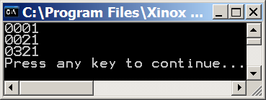
import java.text.DecimalFormat;
public class Output0601
{
public static void main (String args[])
{
DecimalFormat output = new DecimalFormat("0000");
int x = 1;
int y = 21;
int z = 321;
System.out.println(output.format(x));
System.out.println(output.format(y));
System.out.println(output.format(z));
}
}

Slide 6
import java.text.DecimalFormat;
public class Output0602
{
public static void main (String args[])
{
DecimalFormat output = new DecimalFormat("0000");
int a = 1;
int b = 21;
int c = 321;
int d = 4321;
int e = 54321;
System.out.println(output.format(a));
System.out.println(output.format(b));
System.out.println(output.format(c));
System.out.println(output.format(d));
System.out.println(output.format(e));
}
}

Slide 7
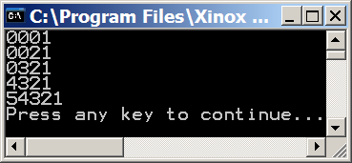
import java.text.DecimalFormat;
public class Output0602
{
public static void main (String args[])
{
DecimalFormat output = new DecimalFormat("0000");
int a = 1;
int b = 21;
int c = 321;
int d = 4321;
int e = 54321;
System.out.println(output.format(a));
System.out.println(output.format(b));
System.out.println(output.format(c));
System.out.println(output.format(d));
System.out.println(output.format(e));
}
}

Slide 8
import java.text.DecimalFormat;
public class Output0603
{
public static void main (String args[])
{
DecimalFormat output = new DecimalFormat("0000");
int a = 10;
int b = a + 25;
int c = b * 2;
int d = a + b + c;
int e = d / 5;
System.out.println(output.format(a));
System.out.println(output.format(b));
System.out.println(output.format(c));
System.out.println(output.format(d));
System.out.println(output.format(e));
}
}

Slide 9
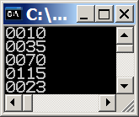
import java.text.DecimalFormat;
public class Output0603
{
public static void main (String args[])
{
DecimalFormat output = new DecimalFormat("0000");
int a = 10;
int b = a + 25;
int c = b * 2;
int d = a + b + c;
int e = d / 5;
System.out.println(output.format(a));
System.out.println(output.format(b));
System.out.println(output.format(c));
System.out.println(output.format(d));
System.out.println(output.format(e));
}
}
variable | process | value
a | N/A | 10
b | 10 + 25 | 35
c | 35 * 2 | 70
d | 10 + 35 + 70 | 115
e | 115 / 5 | 23

Slide 10
import java.text.DecimalFormat;
public class Output0604
{
public static void main (String args[])
{
DecimalFormat output = new DecimalFormat("0,000");
int a = 100;
int b = a * 25;
int c = b * 2;
int d = a + b + c;
int e = d / 5;
System.out.println(output.format(a));
System.out.println(output.format(b));
System.out.println(output.format(c));
System.out.println(output.format(d));
System.out.println(output.format(e));
}
}

Slide 11
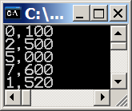
import java.text.DecimalFormat;
public class Output0604
{
public static void main (String args[])
{
DecimalFormat output = new DecimalFormat("0,000");
int a = 100;
int b = a * 25;
int c = b * 2;
int d = a + b + c;
int e = d / 5;
System.out.println(output.format(a));
System.out.println(output.format(b));
System.out.println(output.format(c));
System.out.println(output.format(d));
System.out.println(output.format(e));
}
}
variable | process | value
a | N/A | 100
b | 100 * 25 | 2500
c | 2500 * 2 | 5000
d | 100 + 2500 + 5000 | 7600
e | 7600 / 5 | 1520

Slide 12
import java.text.DecimalFormat;
public class Output0605
{
public static void main (String args[])
{
DecimalFormat money = new DecimalFormat("$0.00");
double hoursWorked = 42;
double hourlyRate = 9.75;
double grossPay = hoursWorked * hourlyRate;
double deductions = grossPay * 0.299;
double netPay = grossPay - deductions;
System.out.println(money.format(grossPay));
System.out.println(money.format(deductions));
System.out.println(money.format(netPay));
}
}

Slide 13
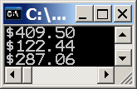
import java.text.DecimalFormat;
public class Output0605
{
public static void main (String args[])
{
DecimalFormat money = new DecimalFormat("$0.00");
double hoursWorked = 42;
double hourlyRate = 9.75;
double grossPay = hoursWorked * hourlyRate;
double deductions = grossPay * 0.299;
double netPay = grossPay - deductions;
System.out.println(money.format(grossPay));
System.out.println(money.format(deductions));
System.out.println(money.format(netPay));
}
}
variable | process | value
hoursWorked | N/A | 42
hourlyRate | N/A | 9.75
grossPay | 42 * 9.75 | 409.5
deductions | 409.5 * 0.299 | 122.4405
netPay | 409.5 – 122.4405 | 287.0595

Slide 14
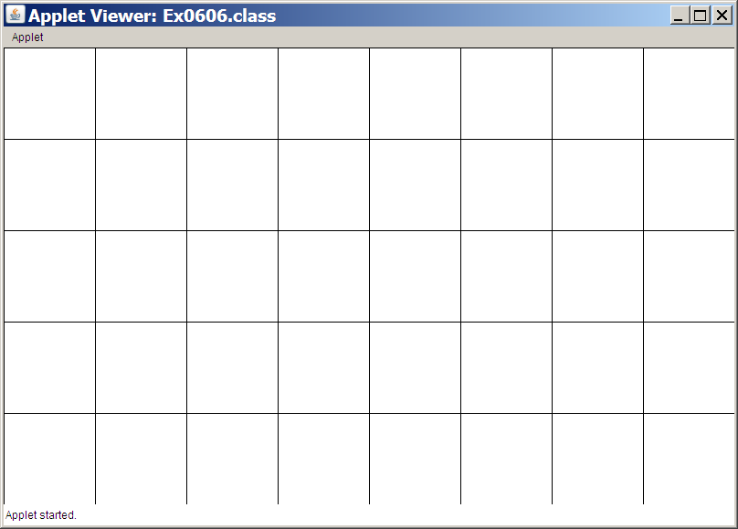
import java.awt.*;
import java.applet.*;
public class Output0606 extends Applet
{
public void paint(Graphics g)
{
Expo.setColor(g,Expo.red);
Polygon z = new Polygon();
z.addPoint(100,200);
z.addPoint(300,100);
z.addPoint(500,100);
z.addPoint(700,200);
z.addPoint(700,300);
z.addPoint(500,400);
z.addPoint(300,400);
z.addPoint(100,300);
g.drawPolygon(z);
}
}
The grid below is 800 X 500.
Each square is 100 X 100.
For the remaining questions if you have a tablet PC try to draw the output on the grid.

Slide 15
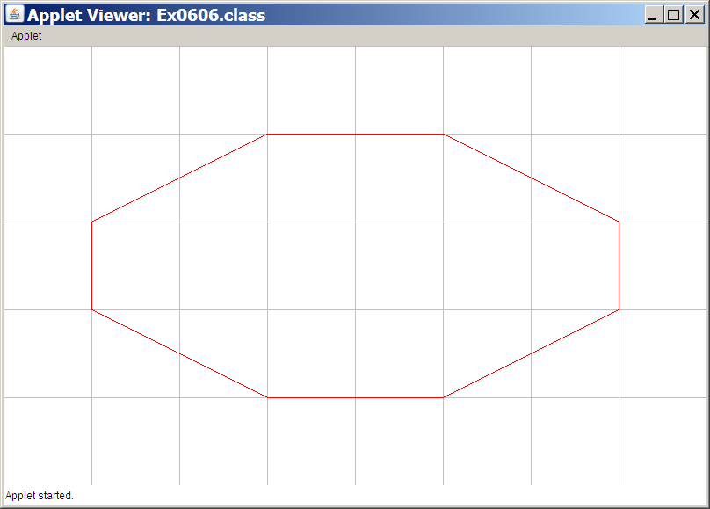
import java.awt.*;
import java.applet.*;
public class Output0606 extends Applet
{
public void paint(Graphics g)
{
Expo.setColor(g,Expo.red);
Polygon z = new Polygon();
z.addPoint(100,200);
z.addPoint(300,100);
z.addPoint(500,100);
z.addPoint(700,200);
z.addPoint(700,300);
z.addPoint(500,400);
z.addPoint(300,400);
z.addPoint(100,300);
g.drawPolygon(z);
}
}

Slide 16
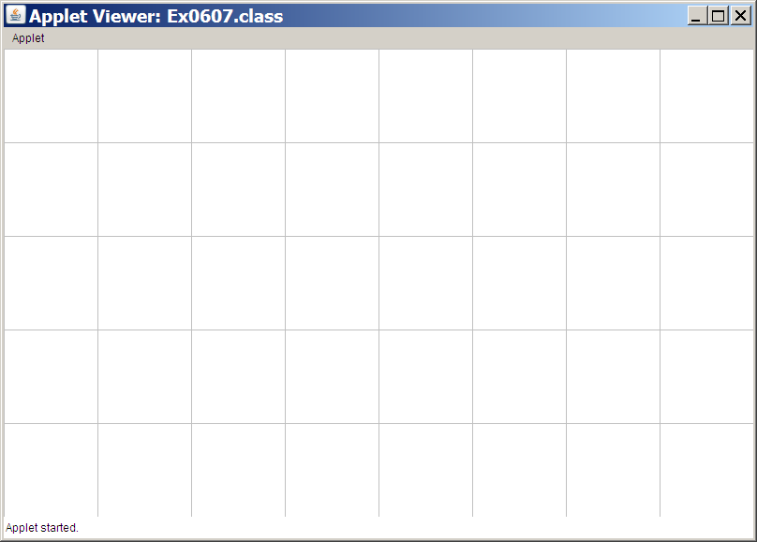
import java.awt.*;
import java.applet.*;
public class Output0607 extends Applet
{
public void paint(Graphics g)
{
Expo.setColor(g,Expo.red);
Polygon z = new Polygon();
z.addPoint(100,200);
z.addPoint(300,100);
z.addPoint(500,100);
z.addPoint(700,200);
z.addPoint(700,300);
z.addPoint(500,400);
z.addPoint(300,400);
z.addPoint(100,300);
}
}

Slide 17
import java.awt.*;
import java.applet.*;
public class Output0607 extends Applet
{
public void paint(Graphics g)
{
Expo.setColor(g,Expo.red);
Polygon z = new Polygon();
z.addPoint(100,200);
z.addPoint(300,100);
z.addPoint(500,100);
z.addPoint(700,200);
z.addPoint(700,300);
z.addPoint(500,400);
z.addPoint(300,400);
z.addPoint(100,300);
}
}
There is no output
because no
drawPolygon
or fillPolygon
command was
ever called.

Slide 18

import java.awt.*;
import java.applet.*;
public class Output0608 extends Applet
{
public void paint(Graphics g)
{
Expo.setColor(g,Expo.red);
Polygon z = new Polygon();
z.addPoint(100,200);
z.addPoint(300,100);
z.addPoint(500,100);
z.addPoint(700,200);
z.addPoint(700,300);
z.addPoint(500,400);
z.addPoint(300,400);
z.addPoint(100,300);
g.fillPolygon(z);
}
}

Slide 19
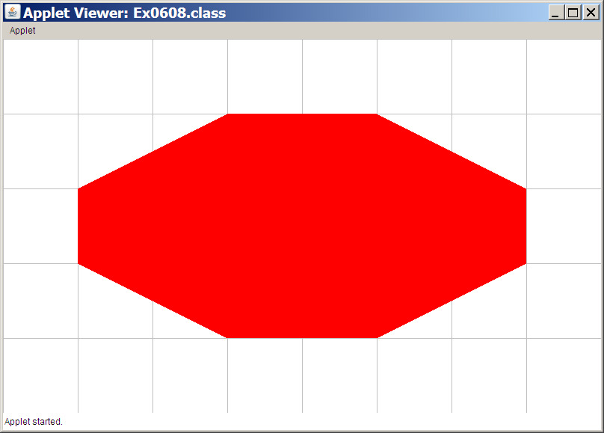
import java.awt.*;
import java.applet.*;
public class Output0608 extends Applet
{
public void paint(Graphics g)
{
Expo.setColor(g,Expo.red);
Polygon z = new Polygon();
z.addPoint(100,200);
z.addPoint(300,100);
z.addPoint(500,100);
z.addPoint(700,200);
z.addPoint(700,300);
z.addPoint(500,400);
z.addPoint(300,400);
z.addPoint(100,300);
g.fillPolygon(z);
}
}

Slide 20

import java.awt.*;
import java.applet.*;
public class Output0609 extends Applet
{
public void paint(Graphics g)
{
Expo.setColor(g,Expo.red);
Polygon z = new Polygon();
z.addPoint(300,400);
z.addPoint(300,100);
z.addPoint(700,300);
z.addPoint(100,300);
z.addPoint(500,100);
z.addPoint(500,400);
z.addPoint(100,200);
z.addPoint(700,200);
g.drawPolygon(z);
}
}

Slide 21
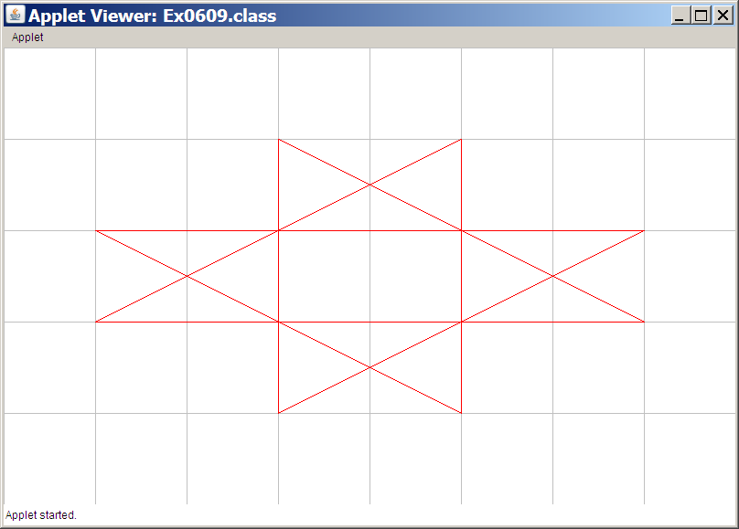
import java.awt.*;
import java.applet.*;
public class Output0609 extends Applet
{
public void paint(Graphics g)
{
Expo.setColor(g,Expo.red);
Polygon z = new Polygon();
z.addPoint(300,400);
z.addPoint(300,100);
z.addPoint(700,300);
z.addPoint(100,300);
z.addPoint(500,100);
z.addPoint(500,400);
z.addPoint(100,200);
z.addPoint(700,200);
g.drawPolygon(z);
}
}
The order in which
you add the points
definitely matters!

Slide 22

import java.awt.*;
import java.applet.*;
public class Output0610 extends Applet
{
public void paint(Graphics g)
{
g.setColor(Color.red);
Font font = new Font("Arial",Font.BOLD,36);
g.setFont(font);
g.drawString("Hello",100,100);
g.drawString("all",600,400);
g.drawString("you",600,100);
g.drawString("happy",100,400);
g.drawString("people.",350,250);
}
}

Slide 23
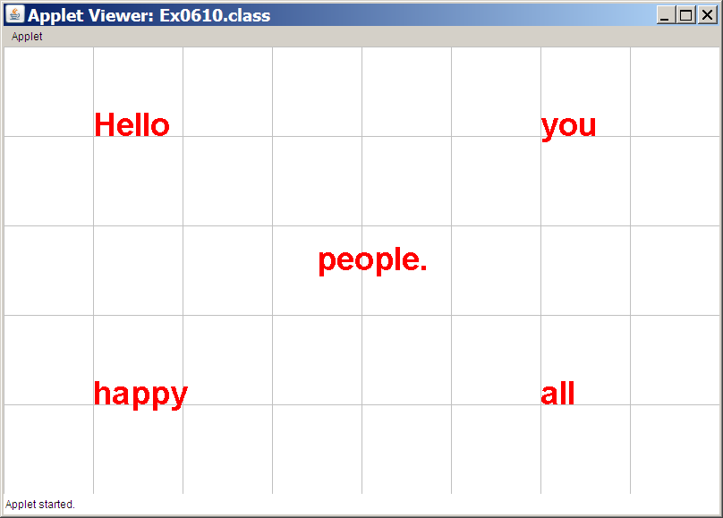
import java.awt.*;
import java.applet.*;
public class Output0610 extends Applet
{
public void paint(Graphics g)
{
g.setColor(Color.red);
Font font = new Font("Arial",Font.BOLD,36);
g.setFont(font);
g.drawString("Hello",100,100);
g.drawString("all",600,400);
g.drawString("you",600,100);
g.drawString("happy",100,400);
g.drawString("people.",350,250);
}
}

